Slide 1
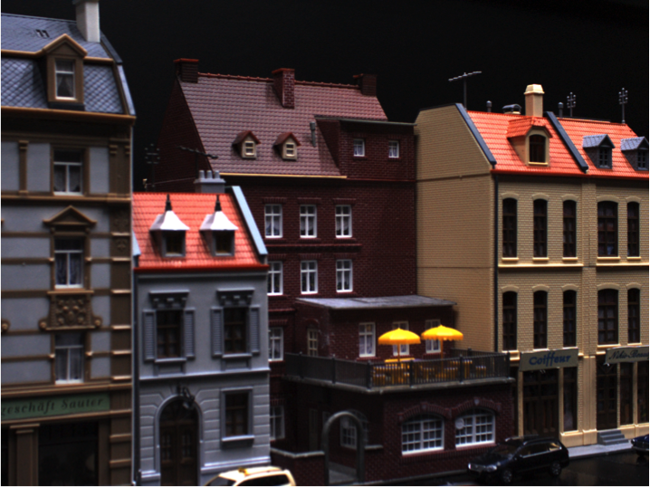
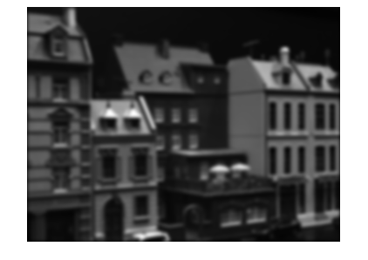
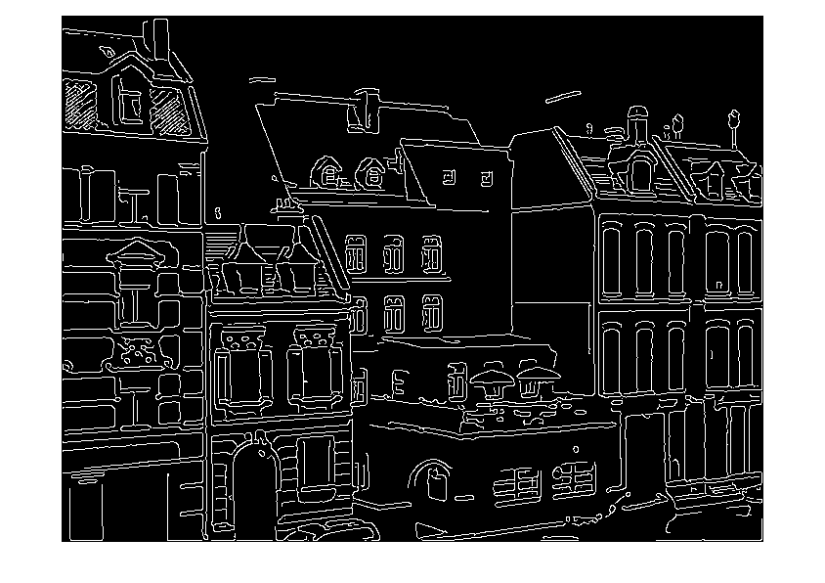
Vision and Image Processing 2021-2022 Filtering and edges
Basic image processing
Notes:
90% of all IP is filtering. 90% of all filtering is Gaussian smoothing

Slide 2
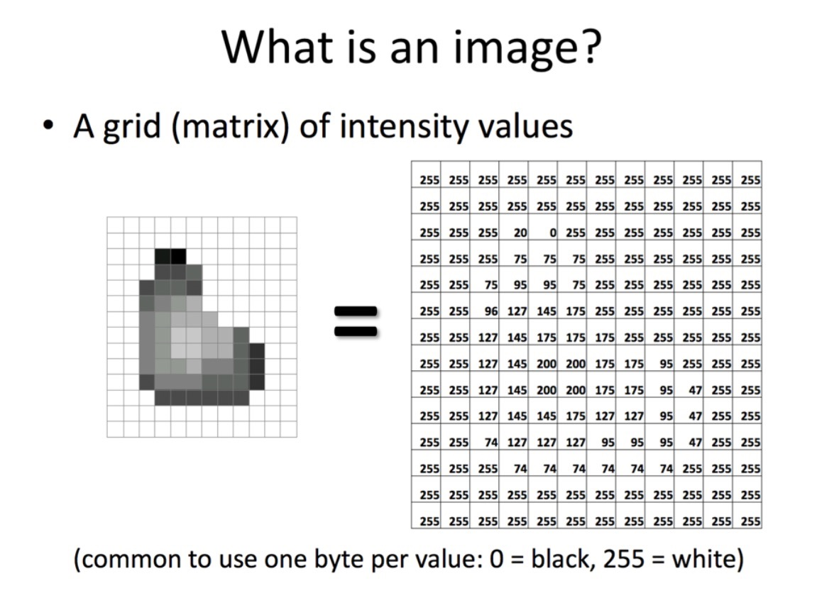

Slide 3

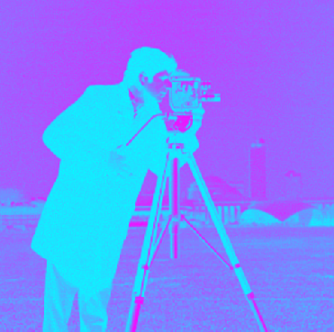
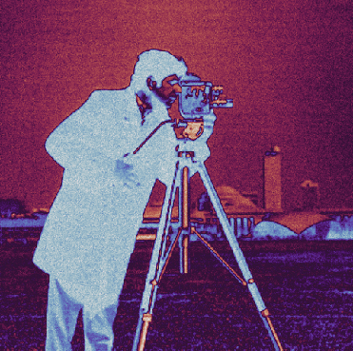
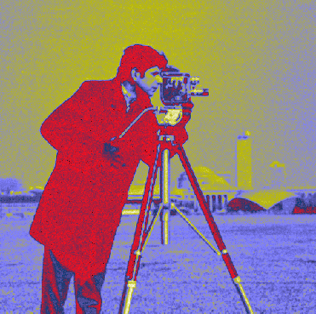
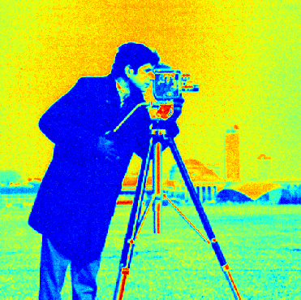
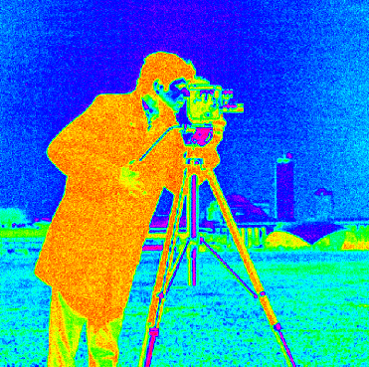
Display of images in your report
Please display single-valued functions (gray scale images) in gray scale and not using some arbitrary color map.
Colormap "greys"
Colormap "cool"
Colormap "twilight"
Colormap "gist_stern"
Colormap "jet"
Colormap "hsv"

Slide 4
What is filtering good for ?
Noise reduction
Elimination of image quantization effects and conversion from integers to floats
Anti aliasing when up/down-scaling
Estimation of image derivatives
Enhancement of specific structures
Detection of image features such as edges and corners

Slide 5
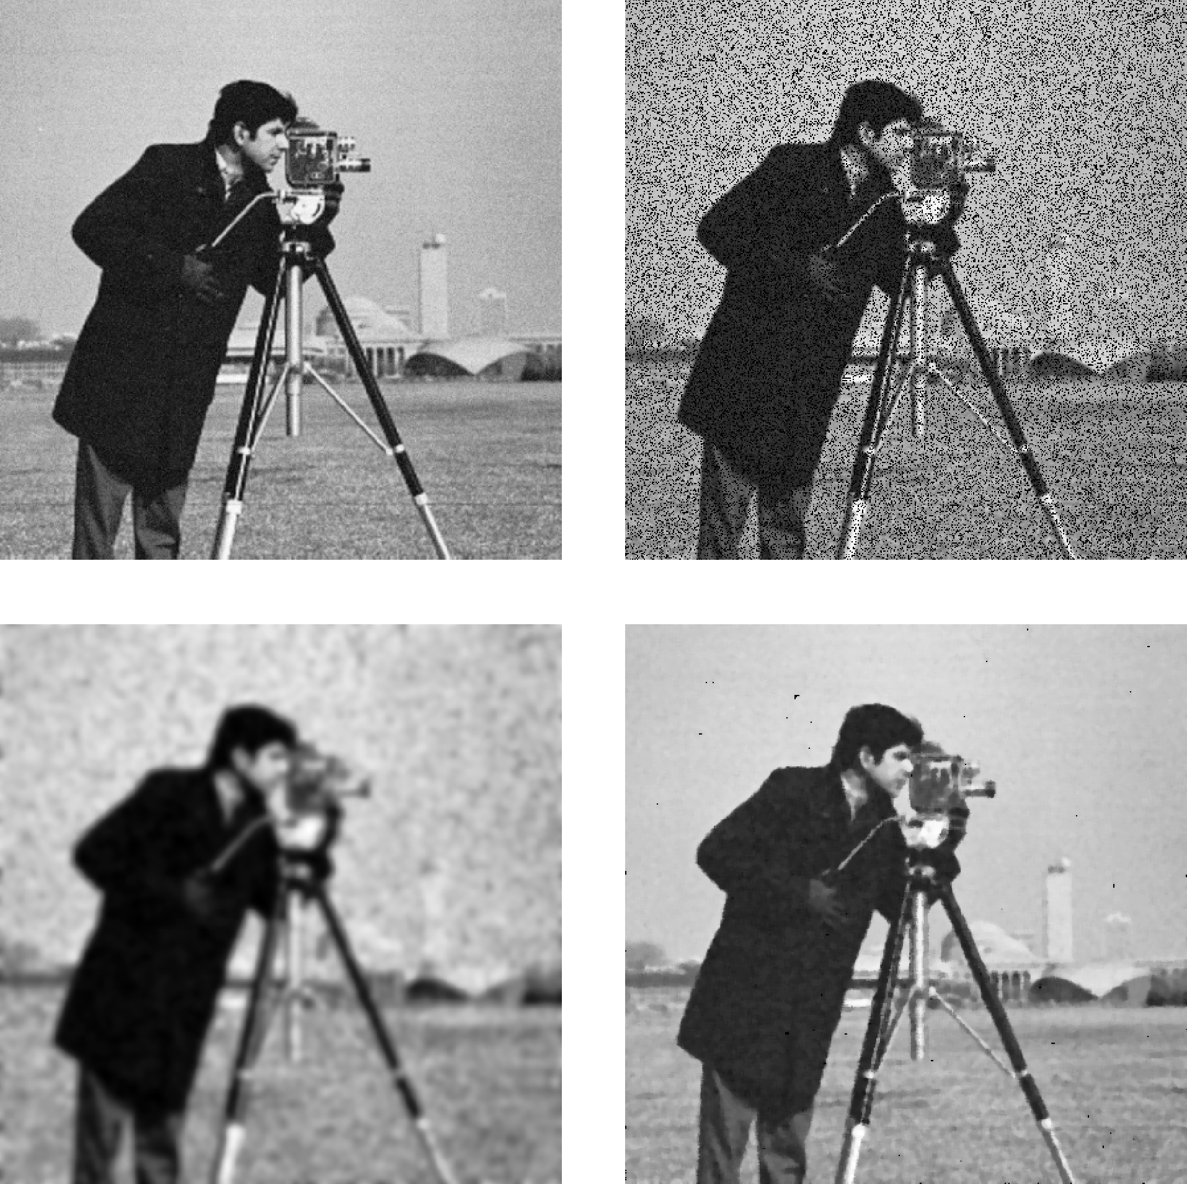
Examples

Slide 6
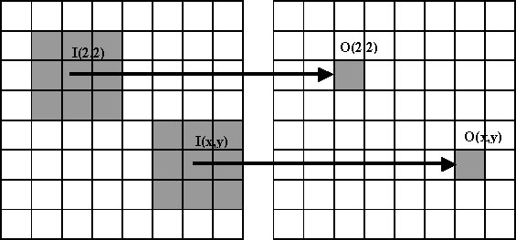
Filtering
Almost all filtering is local, i.e. the filter response in a pixel is computed based on an image patch centered at the pixel.
Many filters are linear and position invariant, implying that the filtering may be described by a convolution.

Slide 7
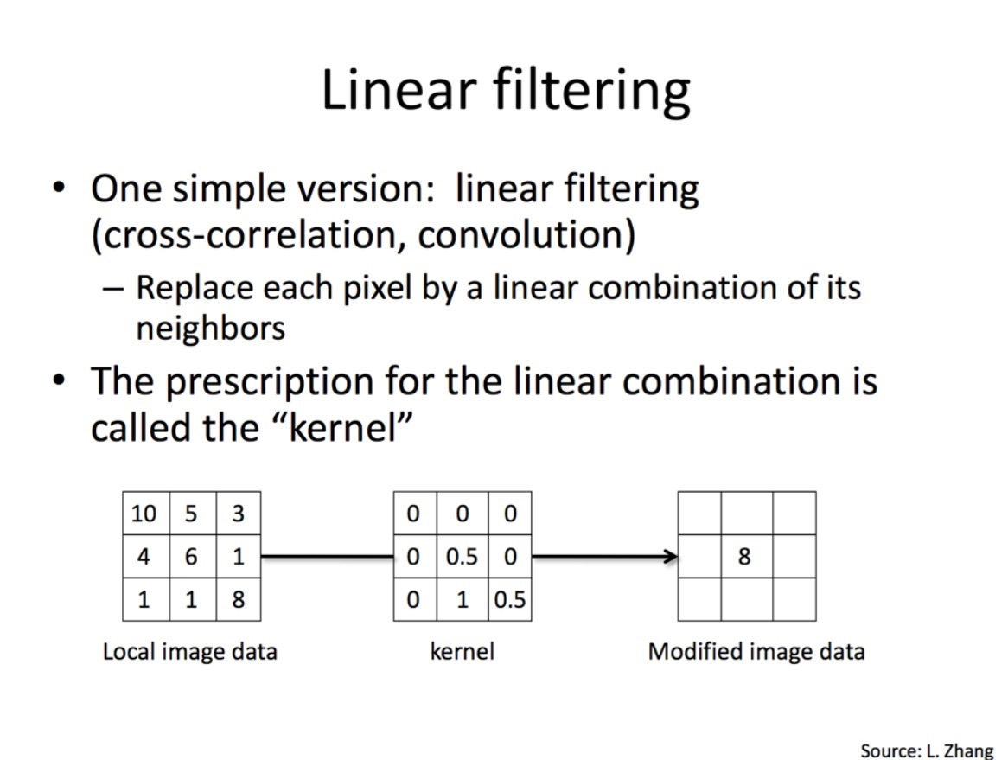

Slide 8
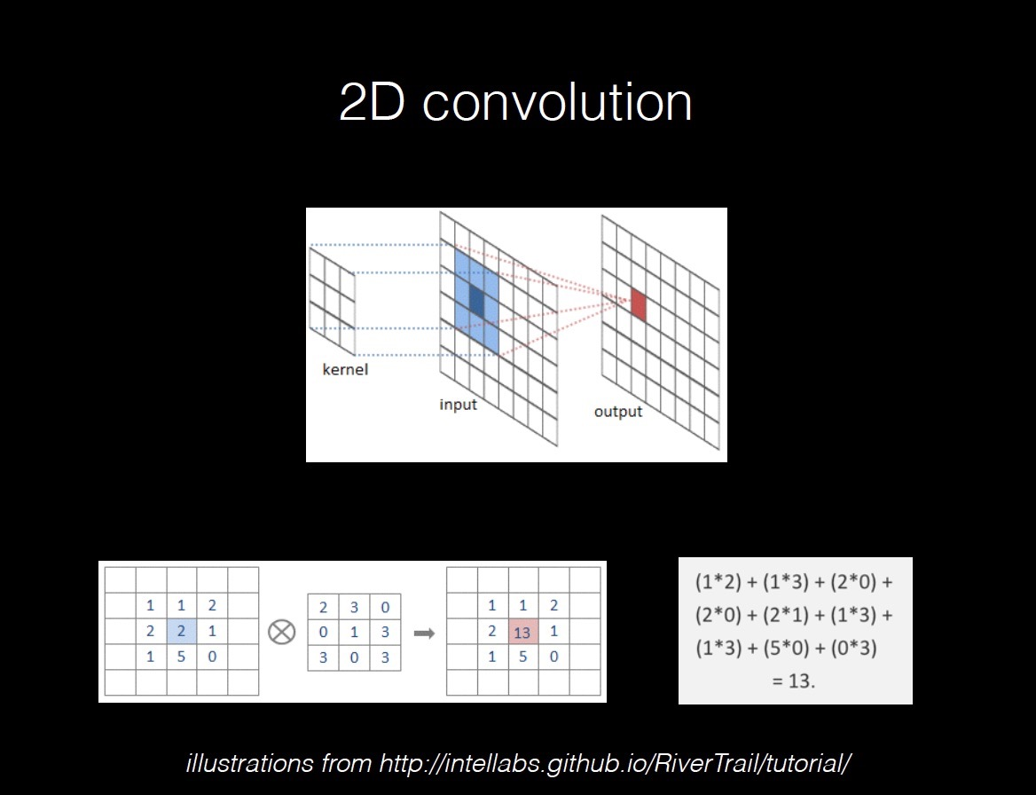

Slide 9
Convolutions
Filtering by discrete convolution
A filter is defined by a filter kernel h(x,y)
Filtering the image I(x,y) with the kernel h(x,y) is defined as
I*h = h*I. Convolving the image with the kernel or the kernel with the image is the same.
Consider filter kernels as images
Filtering slides the reverse filter kernel (or the reverse image) across the image and compute the product sum at each location
The result R(x,y) is called the filter response

Slide 10
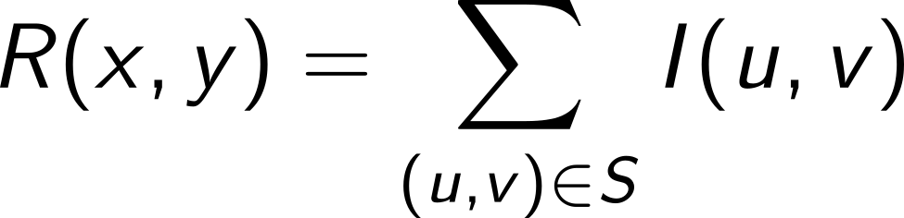
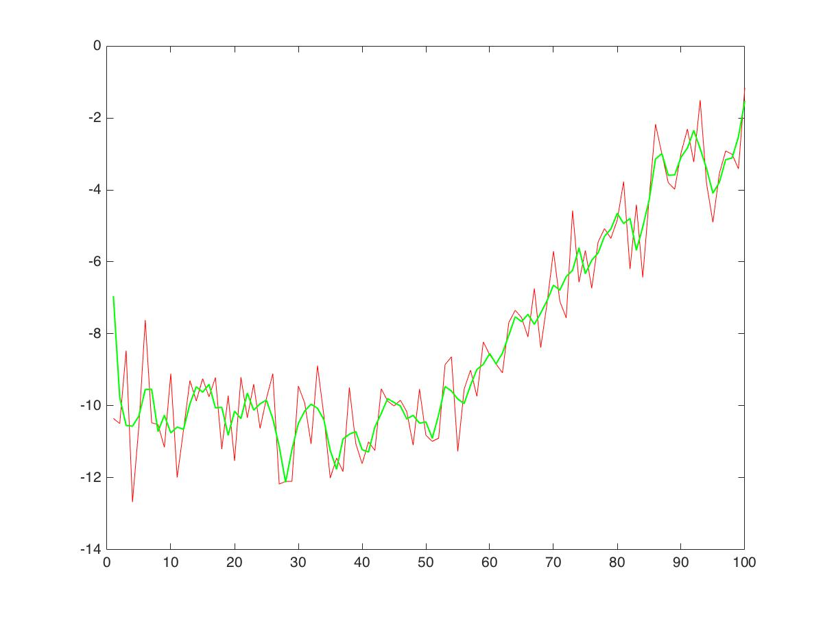
Example
The most simple filter has all values 1. In this case the filter response is just a summation of the neighboring values in the support area S.
Assume the image is 1D and, support area is 3 pixels, and the filter/kernel values are all 1/3. Then the result will be a local running average.

Slide 11
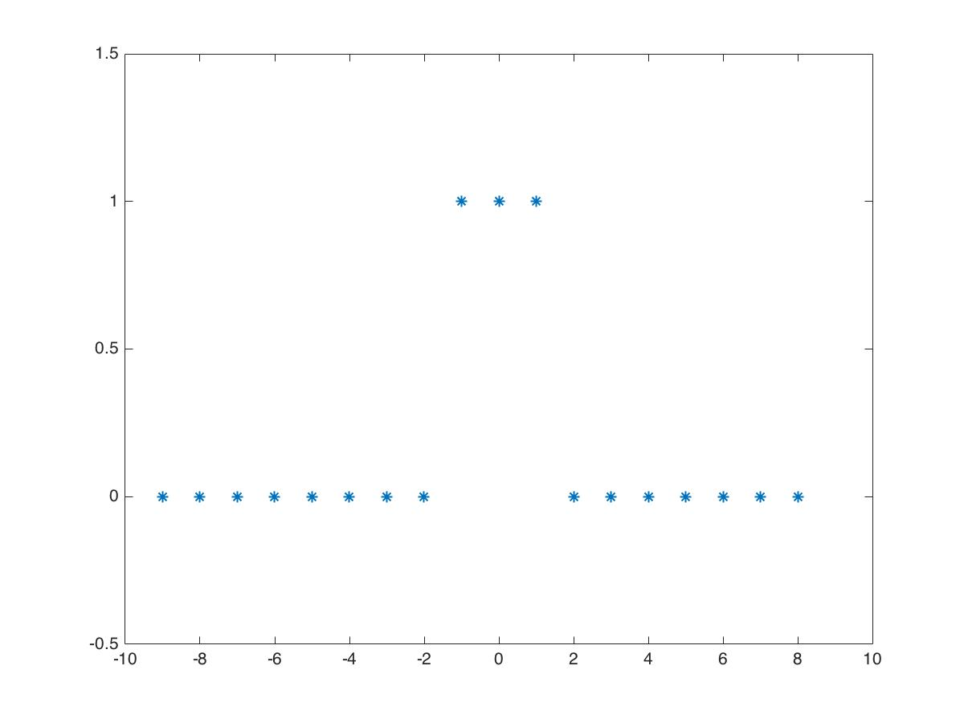
Class exercise
Let f be:
Please use paper and pencil (yes) now (yes!!) and compute the f*f. What is the shape of the resulting signal ?

Slide 12
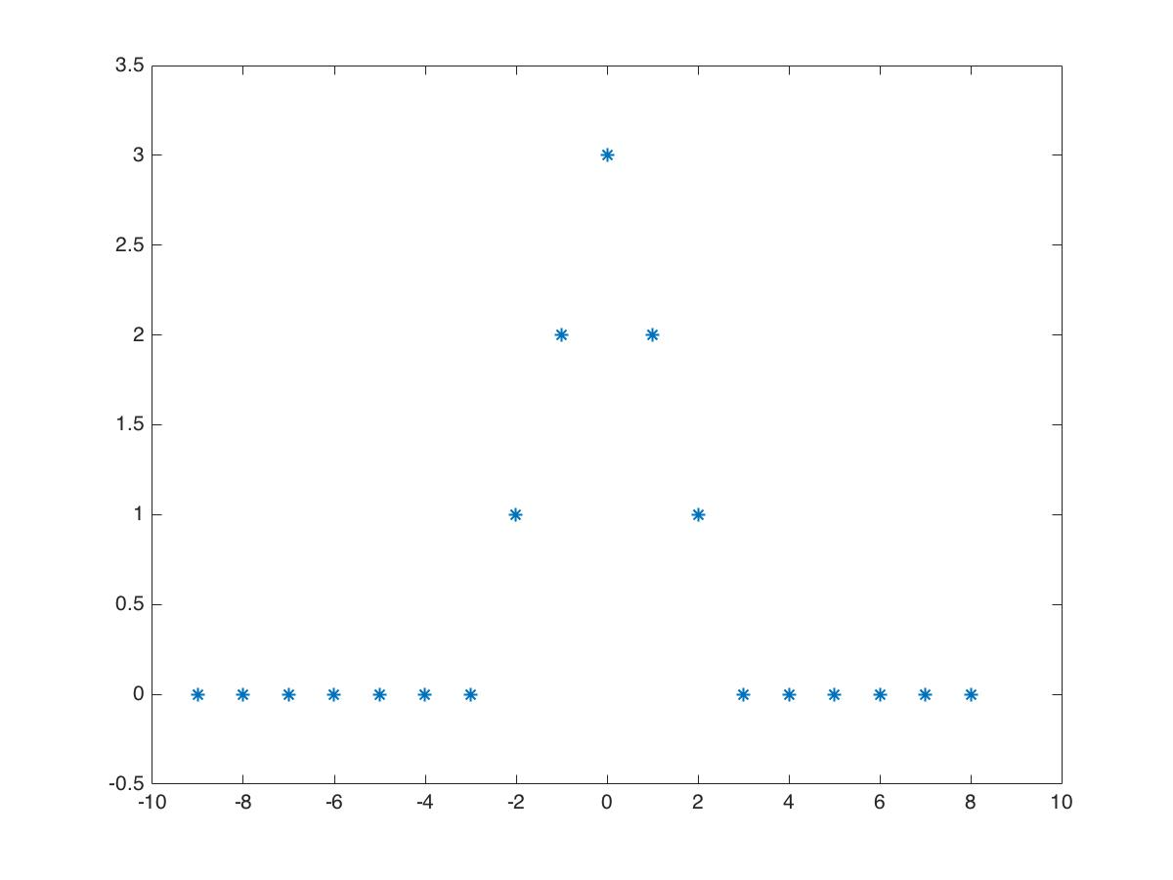
Class exercise
Let f be:
Please use paper and pencil (yes) now (yes!!) and compute f*f.
What is the shape of the resulting signal ?

Slide 13
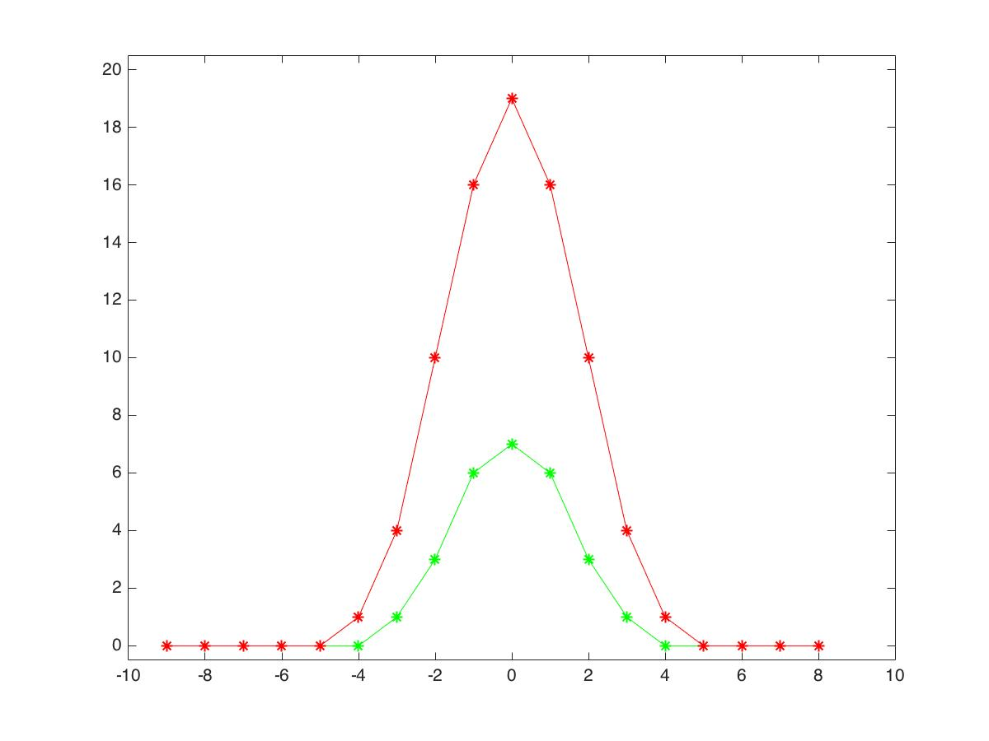
What happens if we compute f*f*f and f*f*f*f
Except from increasing its value the result becomes smoother and gradually more similar to a Gaussian (Normal distribution) (not normalized though)

Slide 14
However
Remember, that in the general case, convolution is:
i.e. we have to:
Mirror one of the images/functions
Slide it to the position (x,y) that we want to measure the convolution result at
Multiply the two images/functions
Sum the product over all pixels, e.g. assuming they are extended by zero values.

Slide 15
What about image borders
For very small and large values of (x,y), x-u may become negative or y-v become larger than image size ?
We don’t know what is outside the image!
Assume zero values outside image border, or
Assume image is mirrored, or
Assume image is extended periodically, or
Don’t! Leave border pixels unaltered

Slide 16
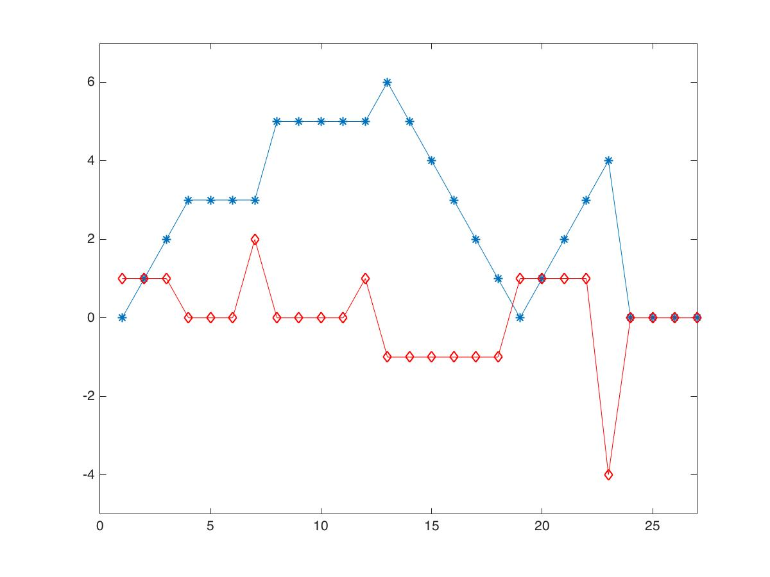
Another example
Now lets try to convolve some data with a difference filter [1,-1]
The difference filter computes an estimate of the rate of change, i.e. the derivative of the data.

Slide 17
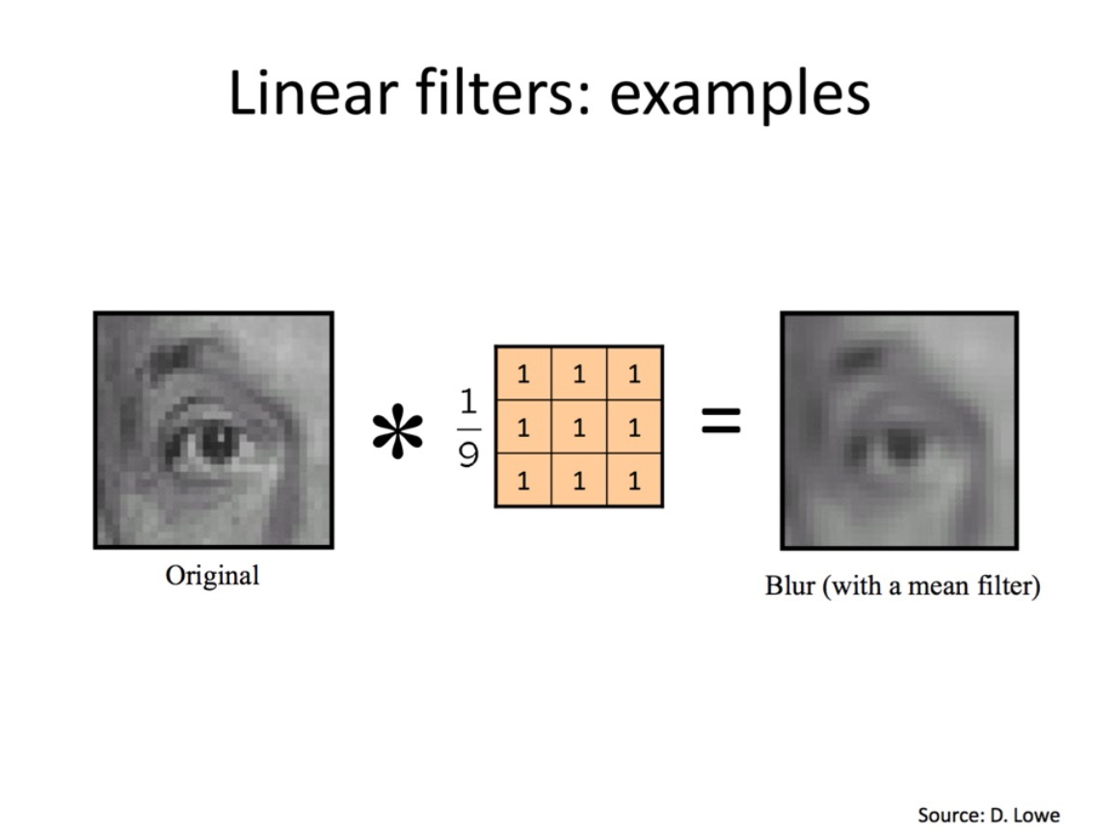

Slide 18
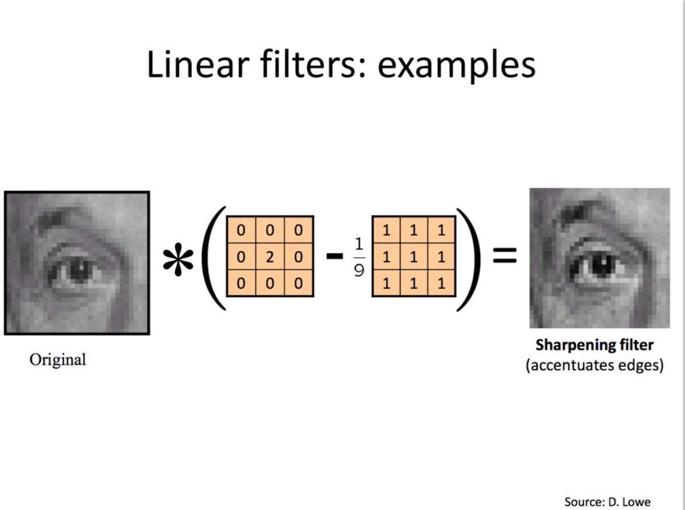

Slide 19
Calculus for convolutions
If f is discrete but g is continuous, the convolution result
will be continuous.
If f is our image and g the noise smoothing filter, we may differentiate f by convolving with the derivative of g.

Slide 20
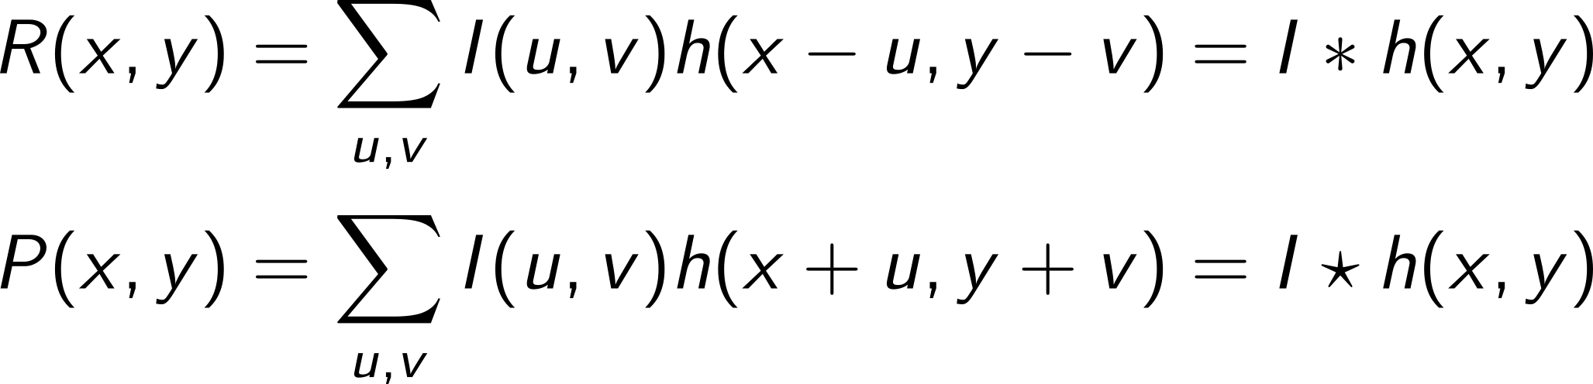
Correlations
Correlation is very similar to convolution
The “-” is replaced by a “+”.
Note for the mathematicians: Really, h should be complex conjugated, but in this course, we assume the filter h real.
If h(x,y) is real and symmetric, convolutions and correlations are identical. In any case: It's still just a local weighted average.
Correlations are often used to find image positions where the image is locally similar to a given image patch.

Slide 21
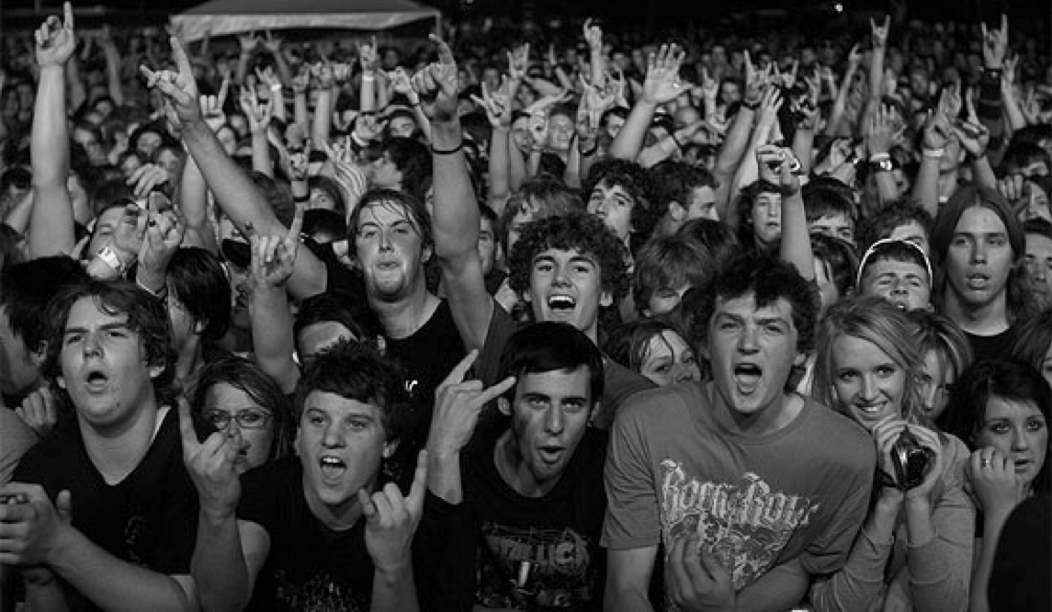

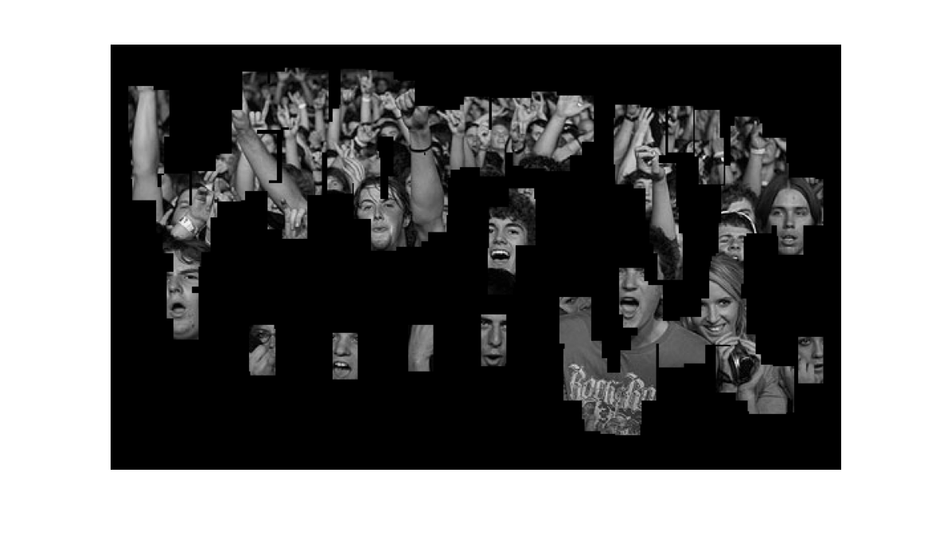
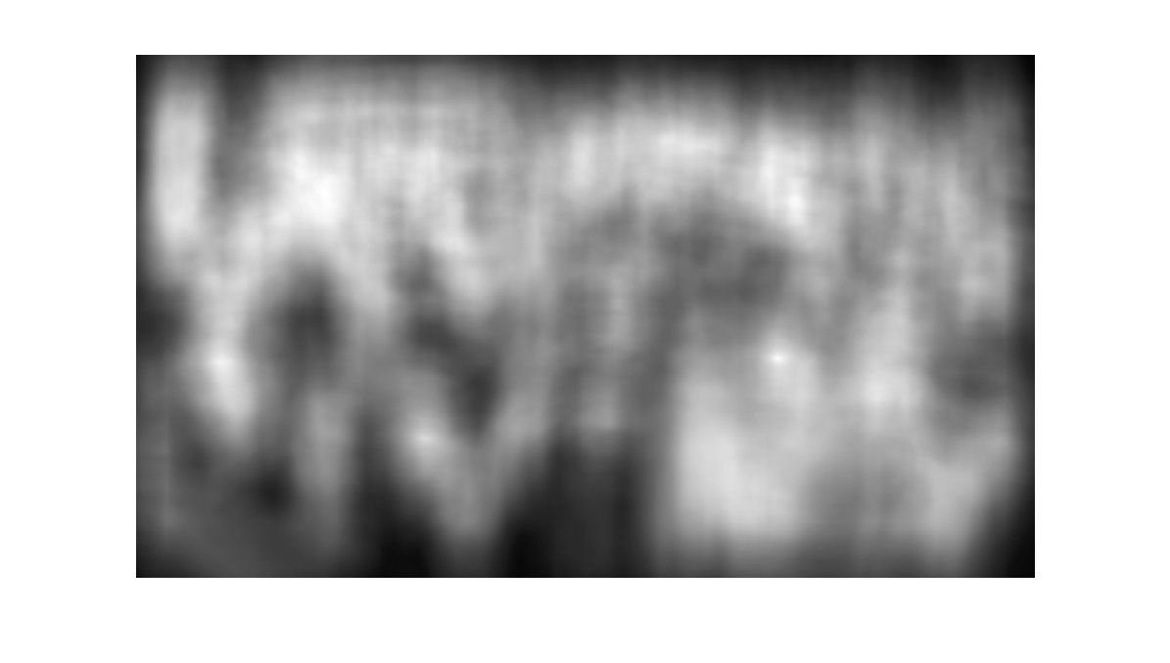

Slide 22
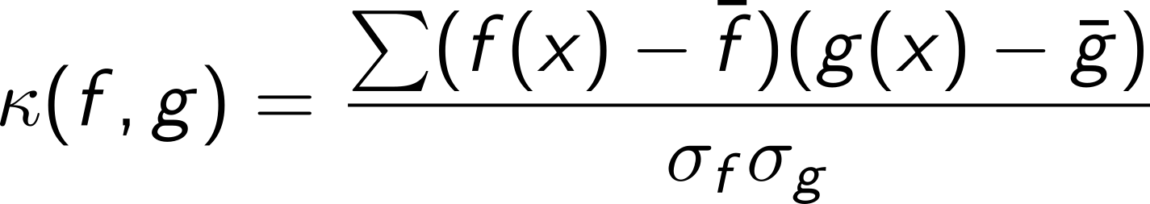
Normalized cross-correlation
The 1D normalized cross correlation (used in previous result) is given by:
with the mean value of f and the spread (or standard deviation).
The correlation coefficient is a real number between -1 and 1 with the latter indicating a strong linear relationship between the two functions. The extension to 2D is straightforward.

Slide 23
Frequency analysis
Similar to sound/music all images may be decomposed into a sum of waves of varying frequencies and orientations.

Slide 24
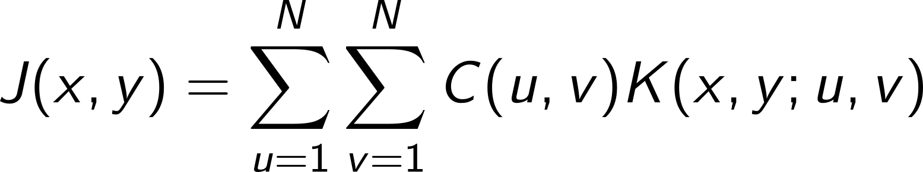
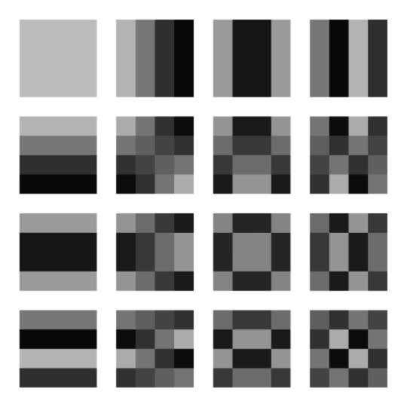
Cosine frequency decomposition
There exists a number of frequency transformations including The Fourier transform (after the mathematician J. B. Joseph Fourier 1768-1830) and the Cosine transform (used in jpeg).
All images J may be constructed as a weighed sum of basis images K(x,y)

Slide 25
Frequency filtering
Some filters are best formulated in the frequency domain.
All linear and position invariant filters may be implemented in both domains, i.e. the spatial domain or the frequency domain.
The Fourier transform F{f} and its inverse F⁻¹{g} provide a tool for going from one domain to the other.
Filtering with large kernels (or filtering with many different kernels) may be implemented faster in the frequency domain than in the spatial domain.

Slide 26
The convolution theorem
The Fourier transform of a convolution is the product of the Fourier transforms:
the tilde denotes functions in the frequency domain.
Similar equation holds for correlations.
For differentiation, another important result is:
Where “i” is the imaginary complex unit. So, if we can Fourier transform and multiply with a polynomial, then it's easy to differentiate (in theory).

Slide 27
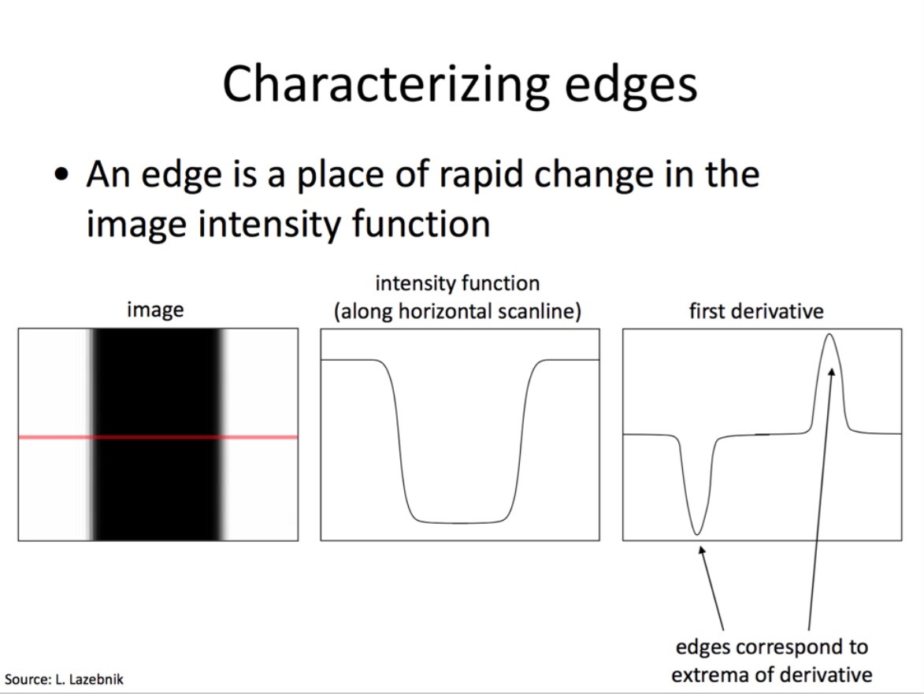

Slide 28
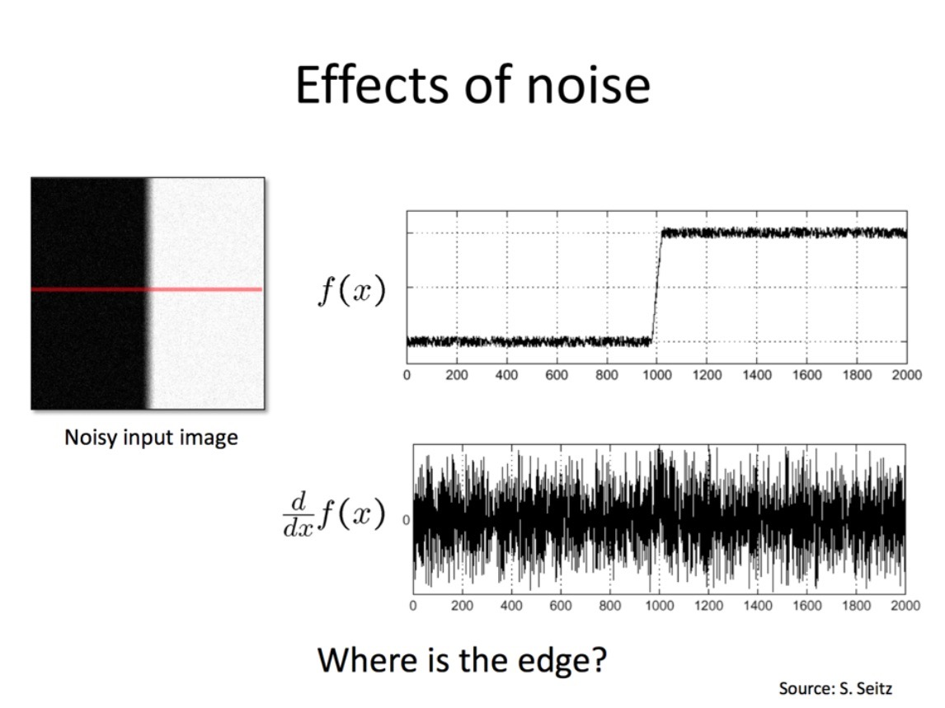

Slide 29
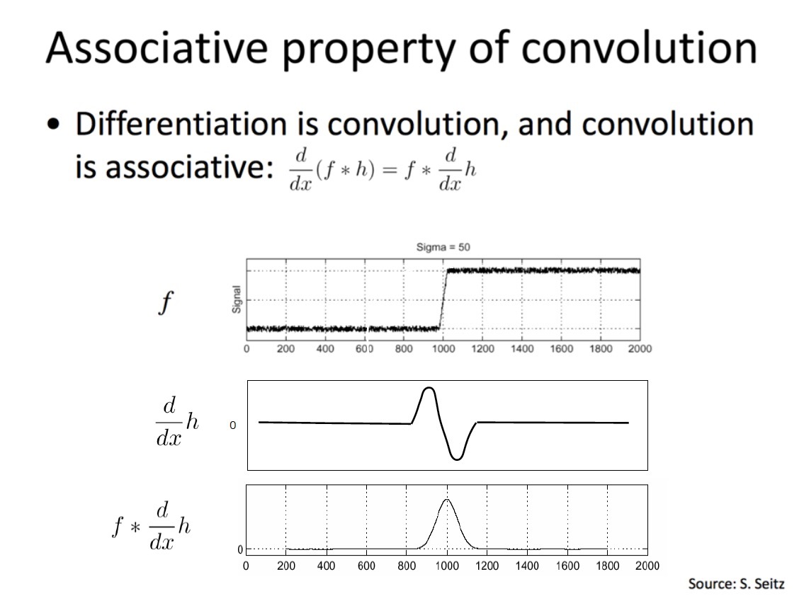

Slide 30
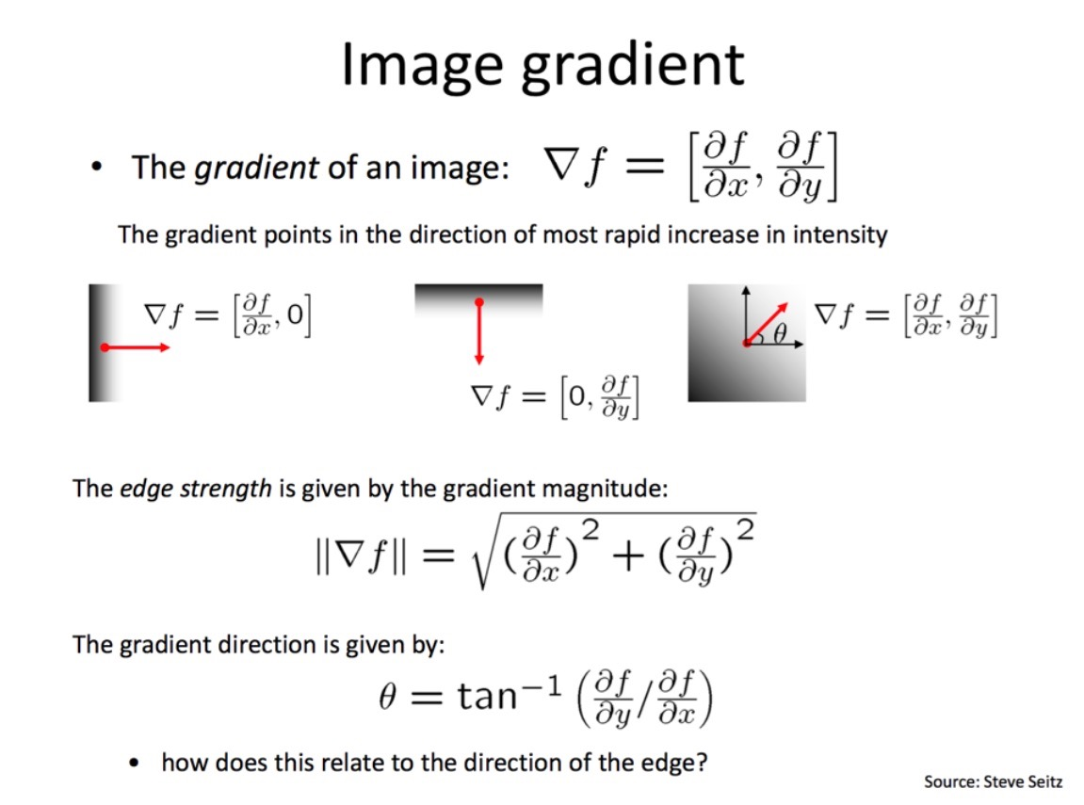

Slide 31
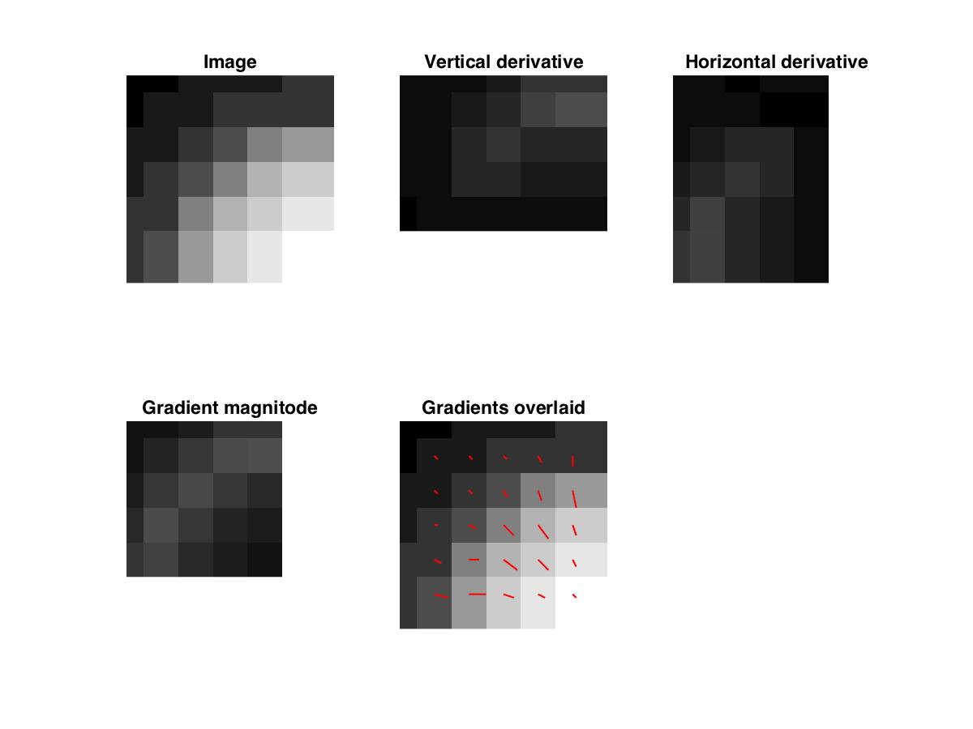
Differentiation
When we differentiate a function f(x), we compute the rate of change.
In 2D there are partial derivatives in the x- and y-axis directions.
The vector of first order partial derivatives is called the gradient. It points at the direction of the largest change and its length, the gradient magnitude, is the contrast.

Slide 32
Why compute image derivatives
Image positions of locally maximal contrast form edges and capture a significant element of the semantics of the image.
Statistical analysis of the local gradient image provides a tool for detecting corners and interest points
Ridges and valleys in the image intensity landscape may be computed from the first and second order partial derivatives.

Slide 33
Why compute image derivatives
Image positions of locally maximal contrast form edges and capture a significant element of the semantics of the image.
Statistical analysis of the local gradient image provides a tool for detecting corners and interest points
Ridges and valleys in the image intensity landscape may be computed from the first and second order partial derivatives.

Slide 34
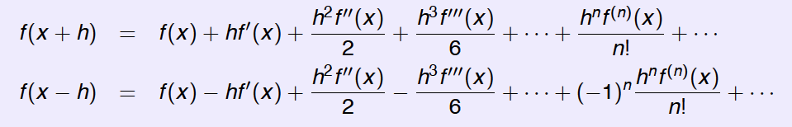
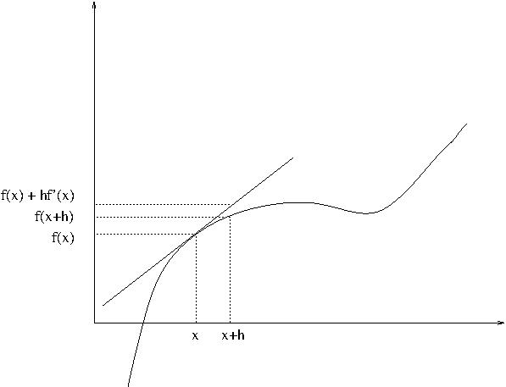
How differentiate a discrete image
A Taylor series expansion of a continuous differentiable 1D function

Slide 35
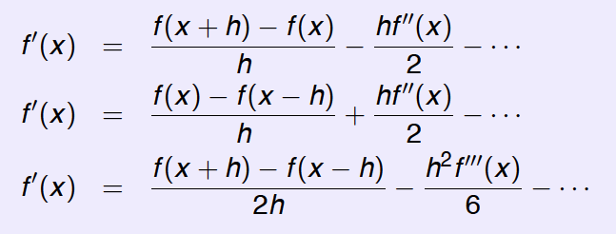
Difference approximations
Ignoring higher order terms we may obtain three discrete difference approximations to the derivative (via Taylor's Theorem):
The last central difference approximation is symmetric which may improve interpretation.

Slide 36
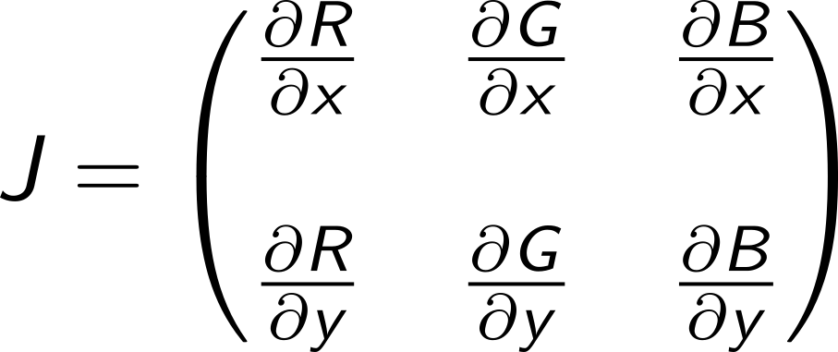
What is the derivative of a color image
A color image is a 3-valued function, so there is 6 first order partial derivatives:

Slide 37
Gaussian filters
The box-filter (with constant values) and the Gaussian filter are two of the most used filters.
The box-filter is fast. The Gaussian has a lot of nice mathematical advantages.
The Gaussian is a normal distribution with a mean value of zero. In 2D we get:

Slide 38
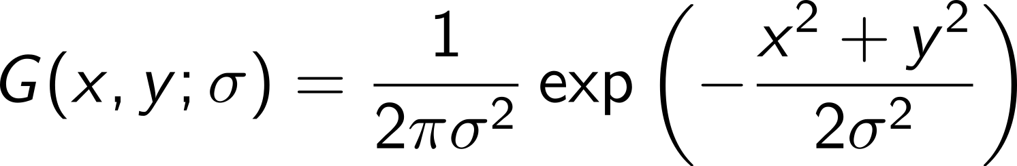
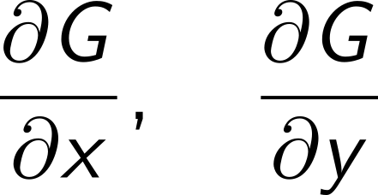
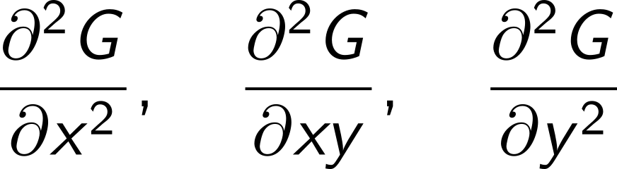
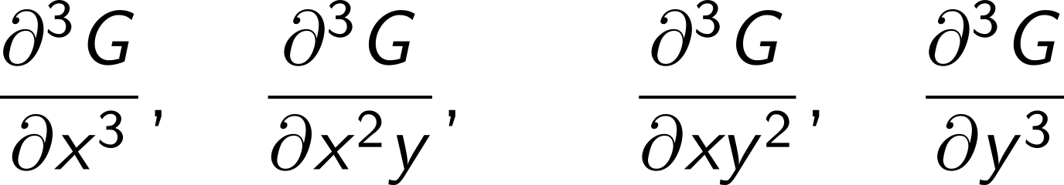
Gaussian derivative filter kernels
Aside: Neurophysiological experiments by Young (1987) show that the receptive field profiles in the human retina and visual cortex can be modeled by Gaussian derivatives.
Notes:
Recall that we want to be to take derivatives of images!
Sigma we refer to as the scale of the filter – it sets the size of the Gaussian bell curve
I simply drew the filters as images by evaluating the filter function at discrete spatial locations (at the pixels)

Slide 39
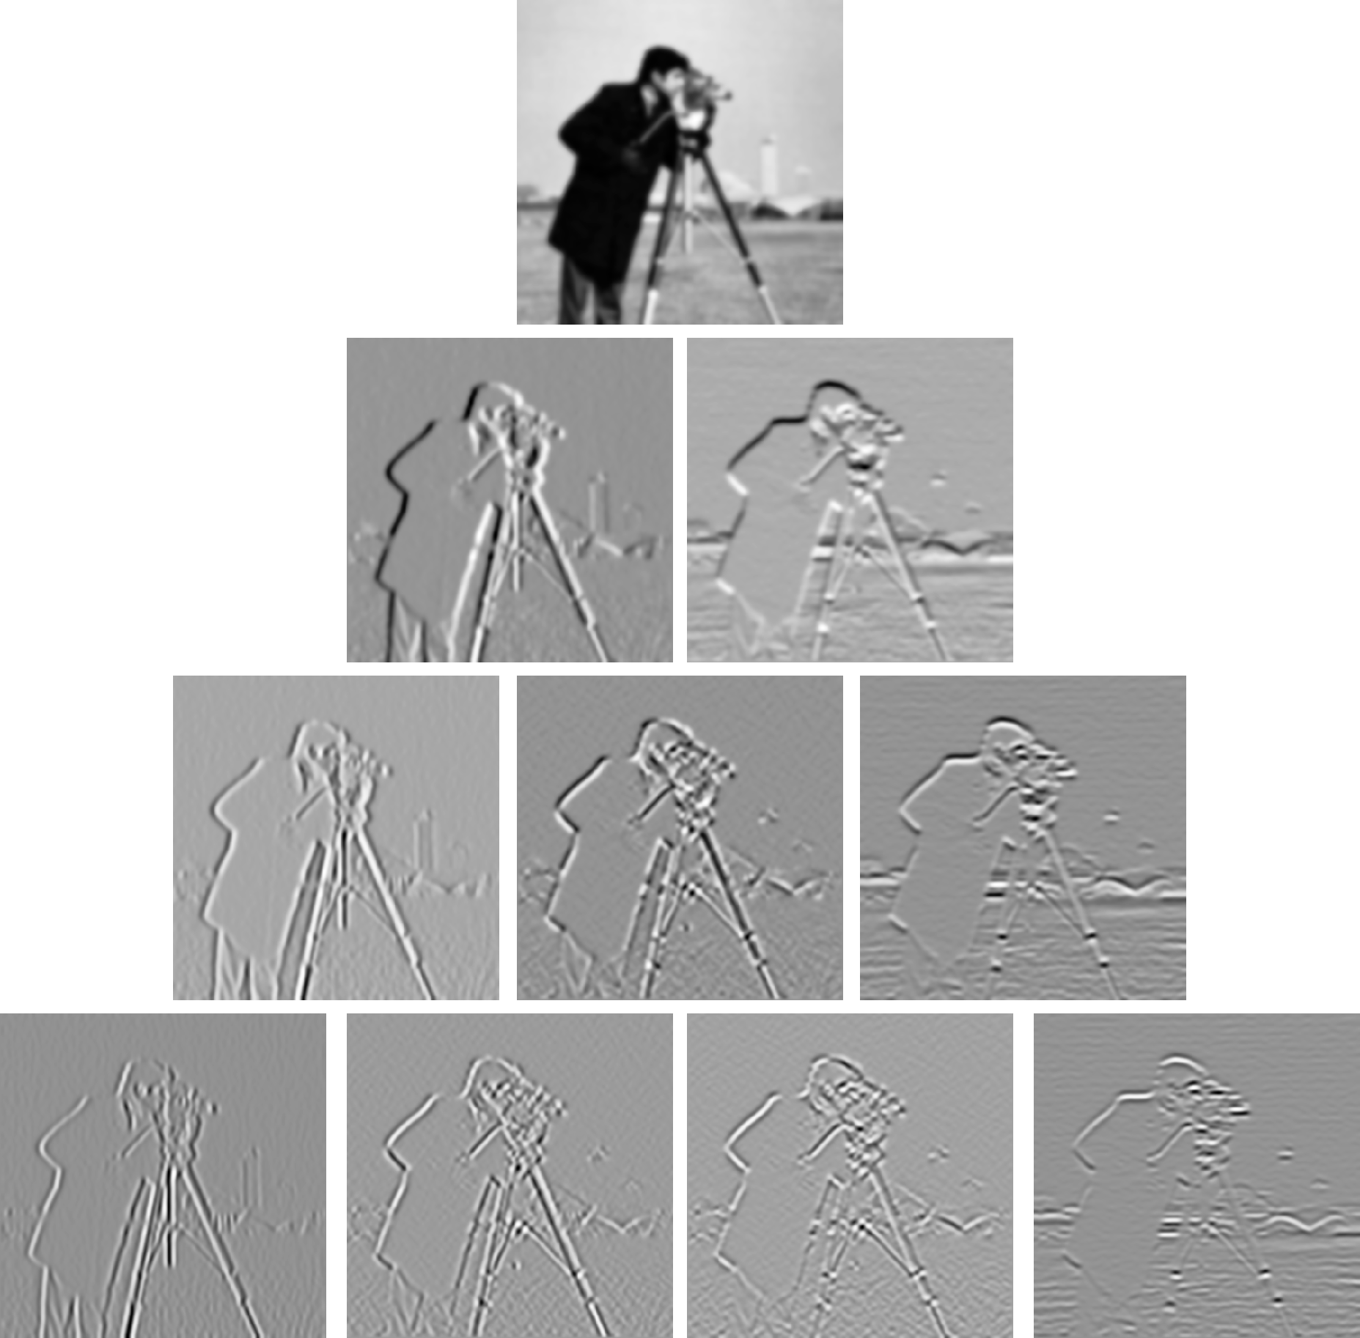
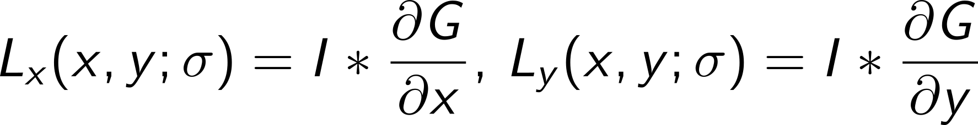
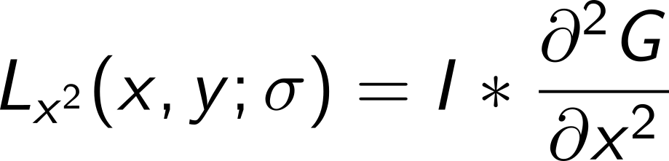
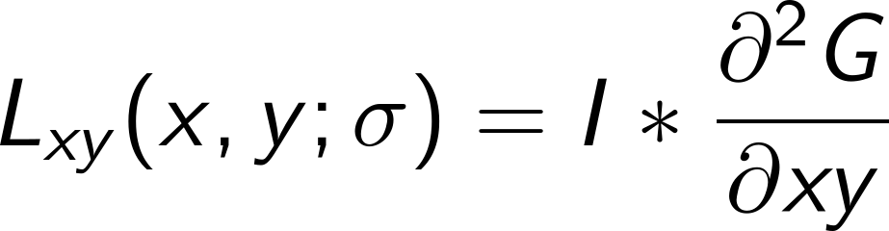
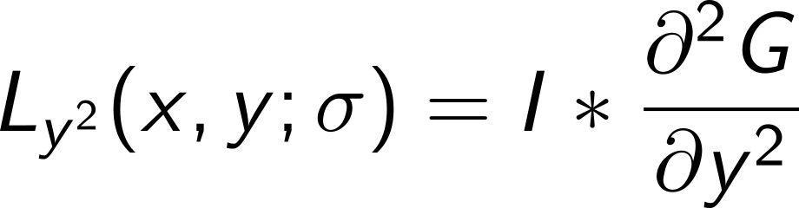
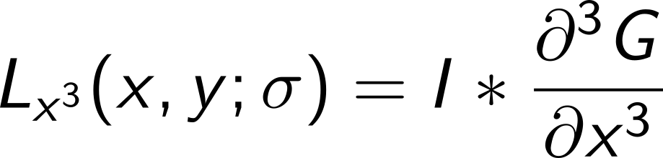
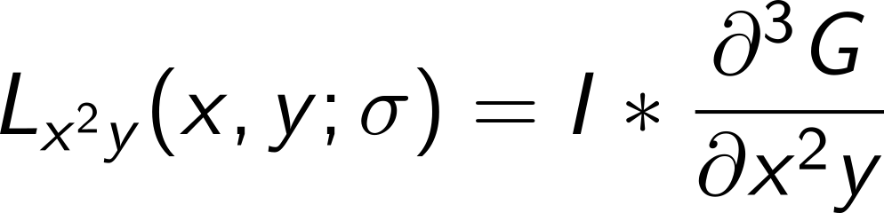
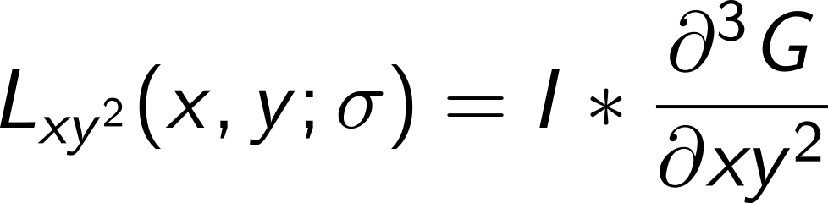
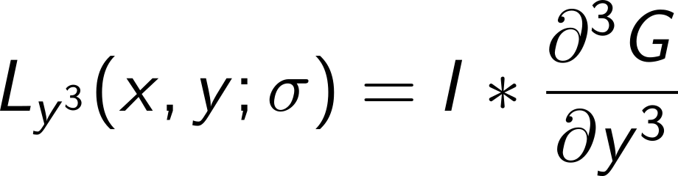
Image derivatives with Gaussian filters
Notes:
Now we can compute image derivatives
Notice the type of structure the derivatives pick up – basically contrast changes such as extrema and intensity edges

Slide 40
Gaussians
Gaussians are the most common smoothing filter because of it simplicity, its unique mathematical properties, and because it is parameterized only by a single parameter, , the scale parameter.
A complete research field area: Scale space analysis has emerged with the focus of analyzing images at several resolution levels, using Gaussians as the basis filter.
The basic problem is that a priori we don’t know the size of what we a looking at. We need to use several filters adapted to the range of possible sizes.

Slide 41


Slide 42
Prewitt and Sobel Filters
Prewitt filters
x direction y direction
Sobel Filters
x direction y direction
Simple 3x3 filters/convolutions
-1 | 0 | 1
-1 | 0 | 1
-1 | 0 | 1
1 | 1 | 1
0 | 0 | 0
-1 | -1 | -1
-1 | 0 | 1
-2 | 0 | 2
-1 | 0 | 1
1 | 2 | 1
0 | 0 | 0
-1 | -2 | -1

Slide 43
Are Prewitt or Sobel as good as Gaussians?
No, they are fixed scale 3x3 masks/kernels, and their mathematical properties lack behind
Can’t I just do Gaussian filtering and then apply say Sobel ? Yes, you can, but it’s not the same as a derivative of a Gaussian
Would it make a big difference in practice? Probably no, but scale-space control might be less obvious.

Slide 44

Scale Space (Witkin 1983)
When a signal is smoothed with gradually increasing sigma, details disappear in a orderly fashion where local minima and maxima meet and annihilate. The Gaussian is the only filter with this property.

Slide 45



Edges at different scales
Depending on the scale parameter value and a gradient threshold value, edges often are broken, disappear, or are connected in unexpected ways.

Slide 46


Edge detection
Edges mark high contrast image structures and capture a large part of the semantics of an image.
For contrast measurement convolution with the derivative of Gaussians often are used (although this can be shown not to be optimal).
Thresholding the gradient magnitude leads to fat edges

Slide 47

Non-maximum suppression
For each pixel (x,y), we interpolate the two gradient magnitude values at points on the grid in the positive and negative gradient direction G.
If the gradient magnitude at (x,y) is larger than both values we mark the point as an edge point.

Slide 48

The Laplacian of a Gaussian (LoG)
The Laplacian is the sum of the two second order partial derivatives:
The filter is the king of blob-filters, may be used to detect edges, and has a center-surround shape similar to ganglion cells in the mammalian visual pathway.

Slide 49

Cross section of G
The filter computes the deviation of the central values from the surroundings.
The filter responds maximally to a white/black spot on a black/white background.

Slide 50

Difference of Gaussians (DoG)

Slide 51

Edge detection using Laplacian Gaussian
The second order derivative is zero where the first order derivative has a maximum.
Smoothing filter
1. derivative
2. derivative
2. derivative of intensity
Intensity profile
Smoothed intensity
Derivative of intensity
Zero crossings of the Laplacian of a Gaussian form very good edges

Slide 52


Blob detection
Blob detection using extremum detection in the convolution of an image with the Laplacian of a Gaussian ideally mark circular spots with a diameter of
Blobs are a main building stone in feature point based image description and will play a central role in the remaining part of the course.

Slide 53
Interest points
When we want to match images or perform Content Based Image Retrieval (CBIR) we need to identify interest points in the images.
Blobs and corners are the most used interest points
Next time we will look at corner detectors and how we may attribute interest points with descriptors.

Slide 54
Summary
Today we have been through:
Filtering: Convolutions and correlations
The convolution theorem
Frequency representation
Differentiation and discrete difference approximations
Gaussians and derivative of Gaussians
Scale Space
Edge detection
Blob detection

Slide 55
2D filter masks
2D filter kernels may be viewed as small images patches or masks. Examples are Prewitt, Box, smoothing, mixed 2nd order derivative.
-1 | 0 | 1
-1 | 0 | 1
-1 | 0 | 1
1 | 1 | 1
1 | 1 | 1
1 | 1 | 1
0.04 | 0.14 | 0.04
0.14 | 0.28 | 0.14
0.04 | 0.14 | 0.04
0.04 | 0.02 | 0.00 | -0.02 | -0.04
0.02 | 0.01 | 0.00 | -0.01 | -0.02
0.00 | 0.00 | 0.00 | 0.00 | 0.00
-0.02 | -0.01 | 0.00 | 0.01 | 0.02
-0.04 | -0,02 | 0.00 | 0.02 | 0.04

